Slide 1



PRESENTATION
By Rashida Shaikh

Slide 2

WHAT IS LLM
A Large Language Model (LLM) is an artificial intelligence system trained on huge amounts of text data to understand and generate human-like language. Examples include GPT-5, GPT-4, Claude, and Gemini.
01

Slide 3
HOW LLM WORKS
1.
Learn from lots of text
The model is trained on books, articles, and websites.
This helps it learn how people use words and sentences.
2.
Break text into small pieces
The text is split into tiny parts (called tokens) — like words or parts of words.
02

Slide 4
3
Find patterns
The model looks at how words appear together and learns patterns — for example:
  “The sky is…” → often followed by “blue.”
  “I want to eat…” → often followed by “pizza,” “food,” etc
4
Guess the next word;-
When you ask a question, the model predicts one word at a time based on what makes the most sense.
5
Form complete sentences
By predicting many words in a row, it can write full sentences, paragraphs, or even essays
02

Slide 5
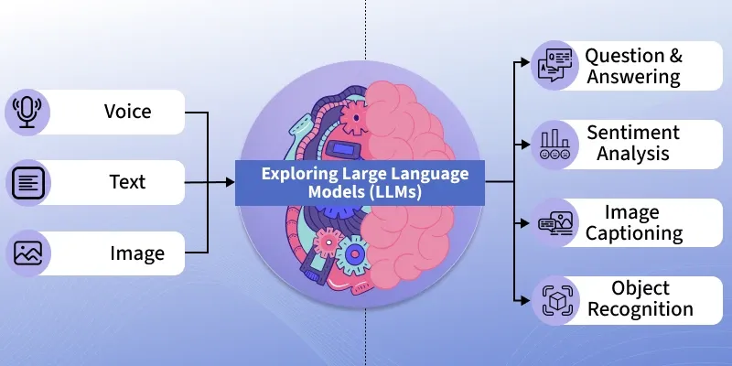
03

